Slide 1
Database Management System CSC-220

Slide 2
Your Responsibilities
As a Student
Attend classes regularly
Ask questions if you have any queries regarding course material or anything
Submit assignments on time
Don’t miss quizzes, assignments, mid term and final examinations – Can get good result ☺
No Plagiarism is allowed in any sort of a written material – Write in your own words

Slide 3
Course Policy
Assignments
Assignments are due at the beginning of class
Late assignments will not be accepted
All works have to be done independently except in case of group assignments
Students handing in similar assignments will receive a grade of 0 (ZERO) and face possible disciplinary actions
Makeup Exams
In accordance with university regulations, i.e. students should bring a valid excuse authenticated through valid channels immediately within first week after the exam
Otherwise they will be considered absent and no makeup exam for them
Mobile Phones
Cell phones are restricted during class. Cell phones must be turned off during the lecture. If your cell phone rings during the class, you may be asked to leave

Slide 4
Course Policy
Attendance
Students are expected to attend all classes
If a student misses more than 12 hours in total without an acceptable reason, the student will be barred from the final exams
Code of Conduct
The assignments, quizzes and exams need to be done individually. Copying of another student's work or code, even if changes are subsequently made, is inappropriate, and such work or code will not be accepted
The University has very clear guidelines for academic misconduct, and they will be enforced in this class
However, in case of group assignments, copying of another group’s work or code, even if changes are subsequently made, is inappropriate, and such work or code will not be accepted

Slide 5
Course Description
The main objective of this course is to provide students with the background to design, implement, and use database management systems. This course shows students how the theory of relational algebra serves as a framework and a foundation for the efficient organization and retrieval of data. It introduces students to some standard notations (for example, SQL) that implement important parts of relational algebra. This course gives students practical experience of the use and limitations of some database notations (such as SQL) that are widely used in industry and business. Transaction processing, concurrency control and recovery techniques, query optimization concepts are also covered.

Slide 6
Course Learning Outcomes
CLO | Statement | Bloom’s Taxonomy | Associated PLO
1 | Define database concepts like Data Models, functional dependencies, transaction processing, concurrency control and recovery techniques etc. | C1 | PLO-1
2 | Explain the concepts and working mechanism related to Data Models, dependencies, normalization, transactions etc. | C2 | PLO-1
3 | Apply appropriate database techniques such as relation algebra, SQL queries, Transaction management, and concurrency management to create solution for different problems | C3 | PLO-3
4 | Design an appropriate database structure for a given business scenario using methods such as: Entity relationship diagrams & Database normalization. | C5 | PLO-2

Slide 7
Marks Distribution

Slide 8
Mapping of CLOs to Course Evaluation Instruments (EI)
EI | CLO’s
 | CLO 1 | CLO 2 | CLO 3 | CLO 4
Assignments | x | x | x | x
Quizzes | x | x | x | x
Midterm Exam | x | x | x | x
Final Exam | x | x | x | x

Slide 9
Course Resources
Text Book:
Carlos Coronel, Steven Morris and Peter Rob. Database Systems: Design, Implementation, and Management, 2016 (12th edition).
Reference Books:
Abraham Silberschatz, Henry F. Korth S. Sudarshan. “Database System Concepts”.
C. J. Date, Database Systems, Addison Wesley Pub. Co.
R. Elmasri and S. Navathe. Fundamentals of Database Systems, Benjamin/Cummings.
T.Connolly and C.Begg. “Database Systems, a Practical Approach to Design, Implementation and Management”, Pearson education.
Philip Greenspun, “SQL for Web Nerds”

Slide 10
Database Systems
Session 1

Slide 11
Session Objectives
In this session, you will learn:
The difference between data and information
What a database is, the various types of databases, and why they are valuable assets for decision making
The importance of database design
How modern databases evolved from file systems
About flaws in file system data management
The main components of the database system
The main functions of a database management system (DBMS)

Slide 12

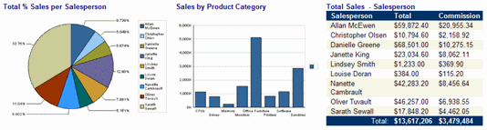
Data versus Information
Data Information
Raw facts
Have not yet been processed to reveal their meaning to the end user
e.g. numbers, characters, graphics,
Produced by processing raw data to reveal its meaning
Requires context
e.g. Total sale for month June, Total
images, audio, video
Building blocks of information
Data management
Generation, storage, and retrieval of data
Data is what you store in database.
students at Bahria Karachi campus
Bedrock of knowledge
Should be accurate, relevant, and timely to enable good decision making
Information is what you retrieve from a database.
ID | Name | Address | City | State
1 | Andrew | SW 16th Ave | Orlando Boston Bronx Albany Detroit ^{r} Austin | FL
2 | Robert | 23rd Terrace |  | MA
3 | Bob | 52nd Avenue |  | NY
4 | Lee Hung | 52nd Avenue |  | NY
g ₅ a n | ^{y} Richard ª | 999 Palm Bay ^{d} |  | MI w
6 | Tony | 15th Avenue |  | TX
Data in Context
Information –
aPliciely aCcchesasirbtl,e BeabrsitGe,raph
®. M
certai
not be sc
product or
nned, copied or
service or otherwise
uplicated, o
on a pass
posted to
ord-prot

Slide 13
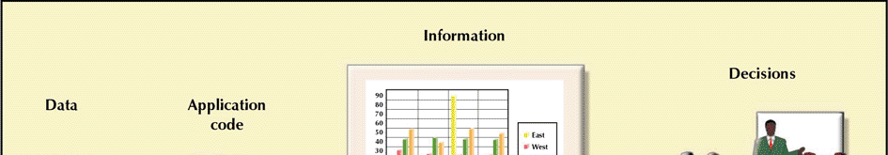

Database: … for Decision Making
(DBMS)
Database Systems: Design, Implementation, & Management: Rob & Coronel

Slide 14
Introducing the Database
Shared, integrated computer structure that stores a collection of:
End-user data - Raw facts of interest to end user
Metadata: Data about data, which the end-user data
are integrated and managed
Describe data characteristics and relationships
Database management system (DBMS)
Collection of programs
Manages the database structure
Controls access to data stored in the database
Name | Data Type | Size | Description
ID | Number | 4 | Unique Student ID
Name | Text | 50 | Student name
Address | Text | 200 | Mailing Address
City | Text | 50 | Residential City
State | Text | 2 | Residential State
ZIP | Number | 5 | ZIP Code
Metadata

Slide 15
Role of the DBMS
Intermediary between the user and the database
Enables data to be shared
Presents the end user with an integrated view of the data
Receives and translates application requests into operations required to fulfill the requests
Hides database’s internal complexity from the application programs and users

Slide 16
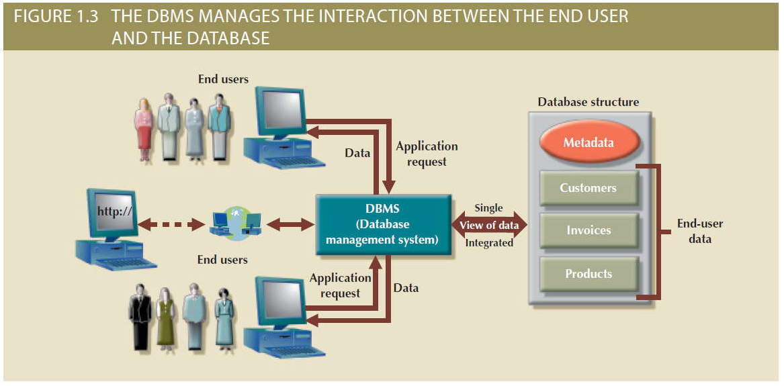
The DBMS Manages the Interaction between the End User and the Database

Slide 17
Advantages of the DBMS
Better data integration and less data inconsistency
Data inconsistency: Different versions of the same data appear in different places
Increased end-user productivity
Improved:
Data sharing
Data security
Data access
Decision making
Data quality: Accuracy, validity, and timeliness of data

Slide 18
Types of Databases
Single-user database: Supports one user at a time
Desktop database: Runs on PC
Multiuser database: Supports multiple users at the same time
Workgroup databases: Supports a small number of users or a specific department
Enterprise database: Supports many users across many departments

Slide 19
Types of Databases
Centralized database: Data is located at a single site
Distributed database: Data is distributed across different sites
Cloud database: Created and maintained using cloud data services that provide defined performance measures for the database

Slide 20
Types of Databases
General-purpose databases: Contains a wide variety of data used in multiple disciplines
Discipline-specific databases: Contains data focused on specific subject areas
Operational database: Designed to support a company’s day-to-day operations

Slide 21
Types of Databases
Analytical database: Stores historical data and business metrics used exclusively for tactical or strategic decision making
Data warehouse: Stores data in a format optimized for decision support
Online analytical processing (OLAP)
Tools for retrieving, processing, and modeling data from the data warehouse
Business intelligence: Captures and processes business data to generate information that support decision making

Slide 22
Types of Databases
Unstructured data: It exists in their original state
Structured data: It results from formatting
Structure is applied based on type of processing to be performed
Semi-structured data: Processed to some extent
Extensible Markup Language (XML)
Represents data elements in textual format

Slide 23
Database Design
Focuses on the design of the database structure that will be used to store and manage end-user data
Well-designed database
Facilitates data management
Generates accurate and valuable information
Poorly designed database causes difficult-to-trace errors

Slide 24
Evolution of File System Data Processing
Manual File Systems
Accomplished through a system of file folders and filing cabinets
Computerized File Systems
Data processing (DP) specialist: Created a computer-based system that would track data and produce required reports
File System Redux: Modern End-User Productivity Tools
Includes spreadsheet programs such as Microsoft Excel

Slide 25
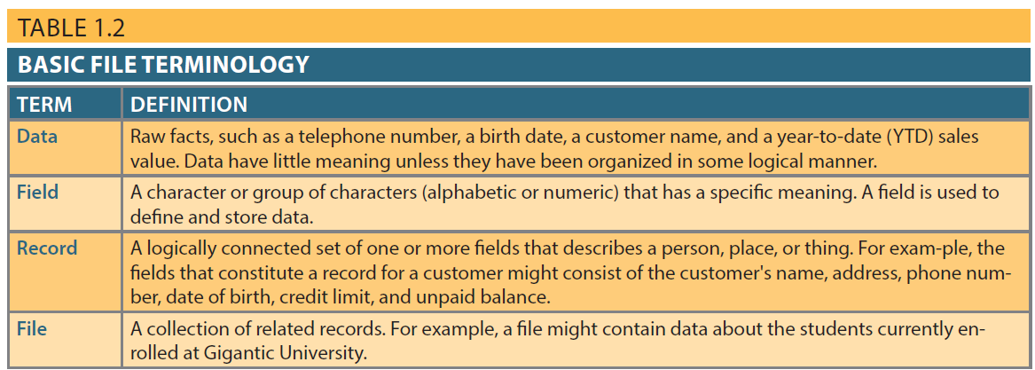
Basic File Terminology

Slide 26
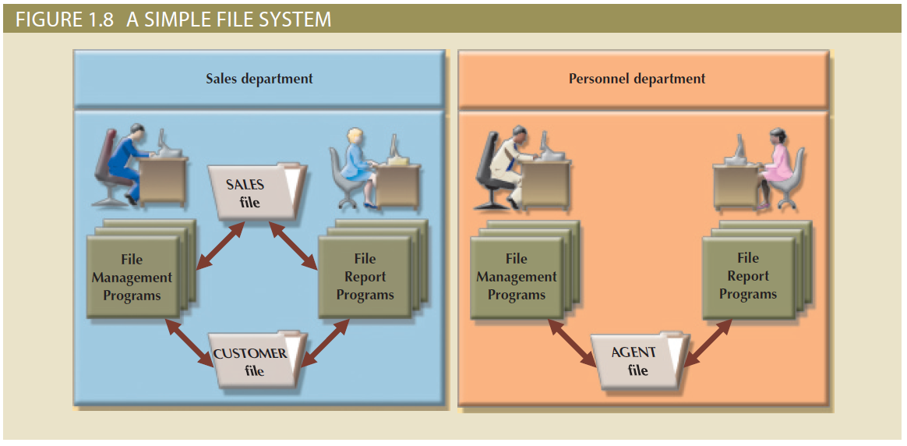
Figure 1.8 - A Simple File System

Slide 27
Problems with File System Data Processing
Lengthy development times
Difficulty of getting quick answers
Complex system administration
Lack of security and limited data sharing
Extensive programming

Slide 28
Structural and Data Dependence
Structural dependence: Access to a file is dependent on its own structure
All file system programs are modified to conform to a new file structure
Structural independence: File structure is changed without affecting the application’s ability to access the data

Slide 29
Structural and Data Dependence
Data dependence
Data access changes when data storage characteristics change
Data independence
Data storage characteristics is changed without affecting the program’s ability to access the data
Practical significance of data dependence is difference between logical and physical format

Slide 30
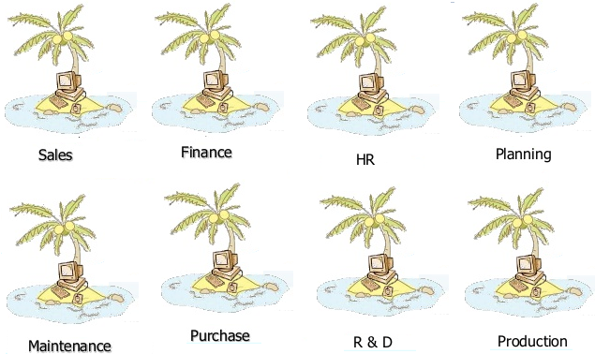
Data Redundancy
Unnecessarily storing same data at different places
Islands of information: Scattered data locations
Increases the probability of having different versions of the same data

Slide 31
Data Redundancy Implications
Poor data security
Data inconsistency
Increased likelihood of data-entry errors when complex entries are made in different files
Data anomaly: Develops when not all of the required changes in the redundant data are made successfully

Slide 32
Types of Data Anomaly
Update Anomalies
Insertion Anomalies
Deletion Anomalies

Slide 33
Database Systems
Logically related data stored in a single logical data repository
Physically distributed among multiple storage facilities
DBMS eliminates most of file system’s problems
Current generation DBMS software:
Stores data structures, relationships between structures, and access paths
Defines, stores, and manages all access paths and components

Slide 34
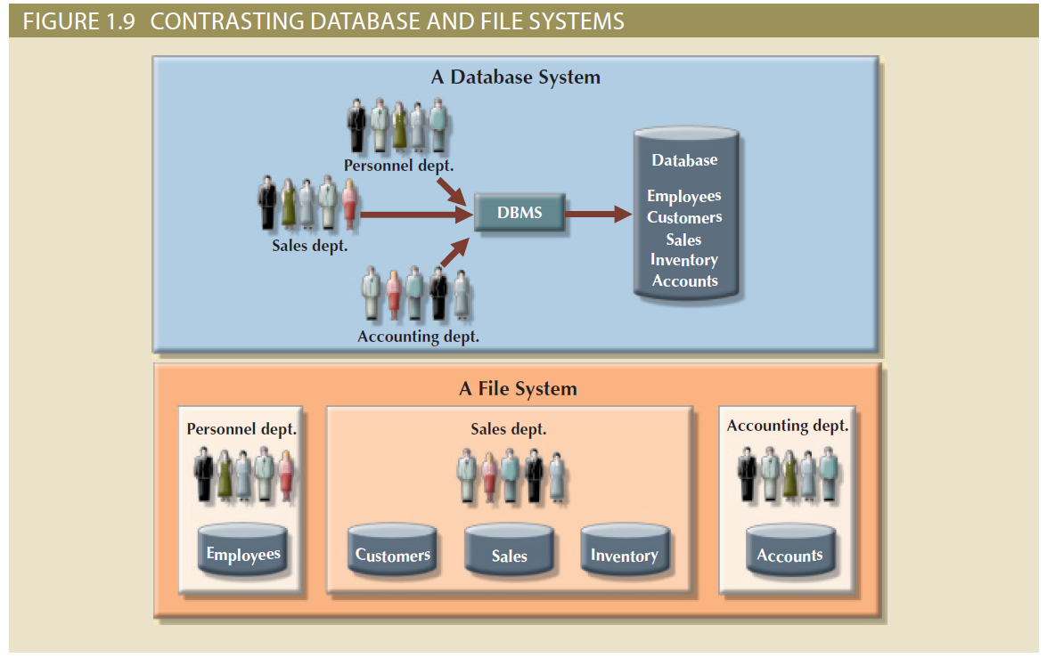
Contrasting Database and File Systems

Slide 35
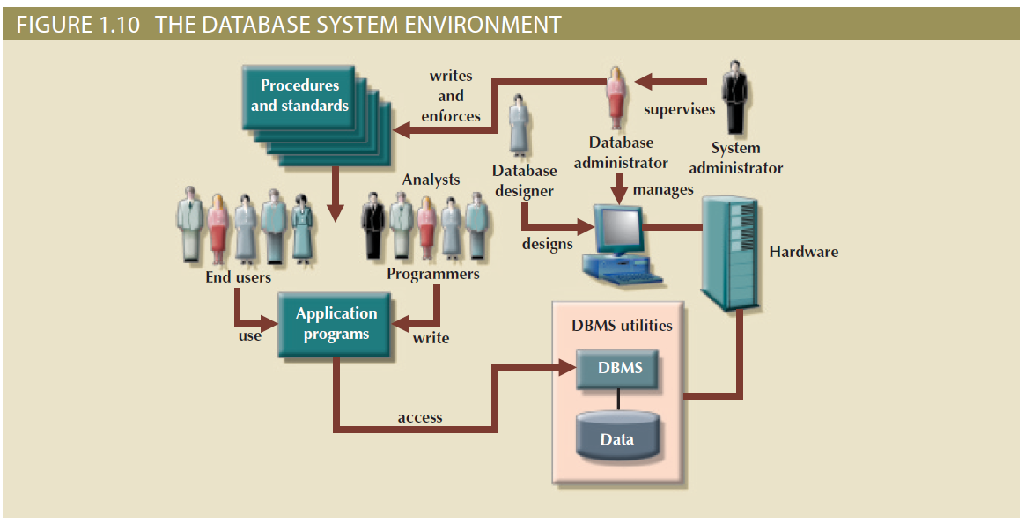
The Database System Environment

Slide 36
DBMS Functions
Data dictionary management
Data dictionary: Stores definitions of the data elements and their relationships
Data storage management
Performance tuning: Ensures efficient performance of the database in terms of storage and access speed
Data transformation and presentation
Transforms entered data to conform to required data structures
Security management
Enforces user security and data privacy

Slide 37
DBMS Functions
Multiuser access control
Sophisticated algorithms ensure that multiple users can access the database concurrently without compromising its integrity
Backup and recovery management
Enables recovery of the database after a failure
Data integrity management
Minimizes redundancy and maximizes consistency

Slide 38
DBMS Functions
Database access languages and application programming interfaces
Query language: Lets the user specify what must be done without having to specify how
Structured Query Language (SQL): De facto query language and data access standard supported by the majority of DBMS vendors
Database communication interfaces
Accept end-user requests via multiple, different network environments

Slide 39
Disadvantages of Database Systems
Increased costs
Management complexity
Maintaining currency
Vendor dependence
Frequent upgrade/replacement cycles

Slide 40
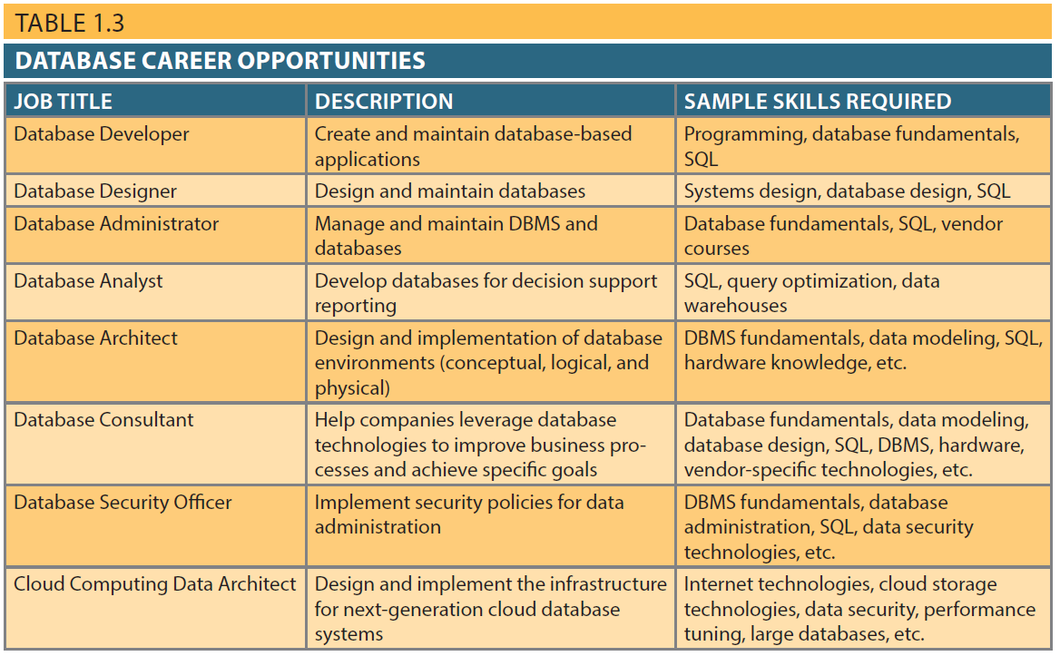
Database Career Opportunities

